Slide 1
FURNITURE SALES FORECASTING

Slide 2
OBJECTIVE :
To Analyze sales of furniture from 2014-2017.
To forecast 2018 furniture sales by leveraging time series data.

Slide 3
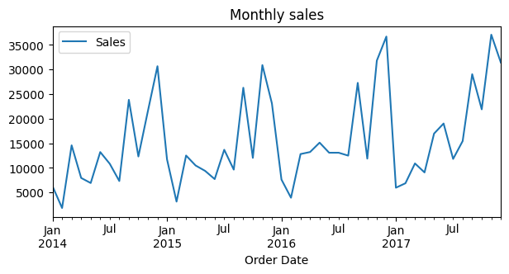
ANALYZE THE DATA :
The sales are least in the months of January and February.
The sales are high in the months of December and November.
The sales are having some pattern like having minimum sales at the start of the year and reaching maximum at end of the year

Slide 4
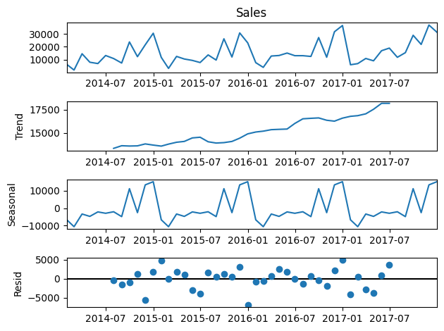
COMPONENTS OF TIME SERIES :
Trend, Seasonality, Cyclic, Irregularities are the components of time series.
The data shows that sales have upwards trend which shows the sales tend to rise over time.
The seasonal variations shows that there is regular pattern over a regular period of time. In our data the sales are having annual seasonality.

Slide 5
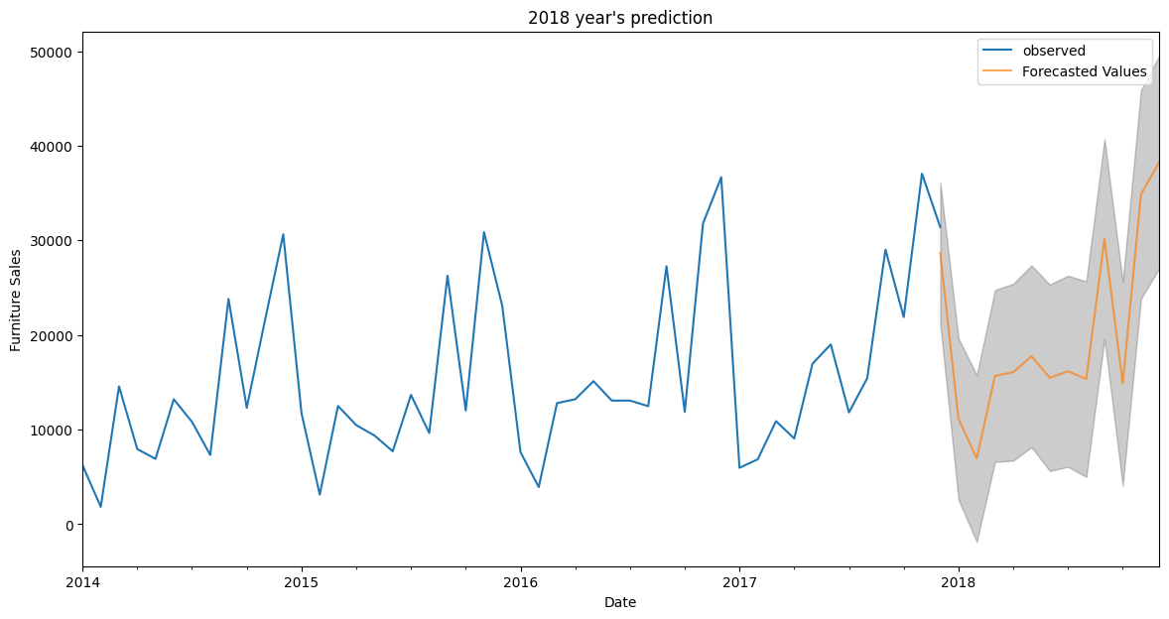
USING SARIMAX MODEL TO FORECAST FUTURE SALES

Slide 6
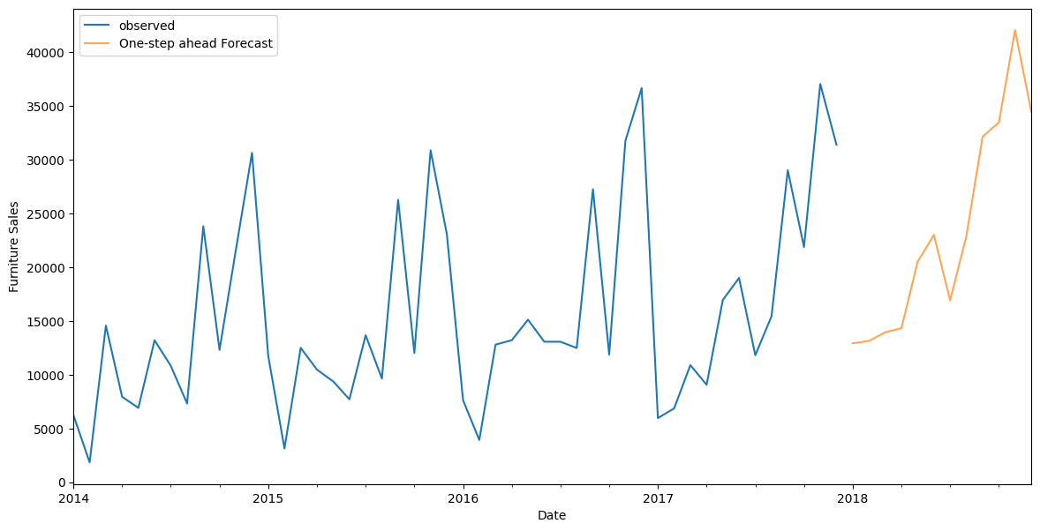
USING LSTM TO PREDICT 2018 SALES

Slide 7
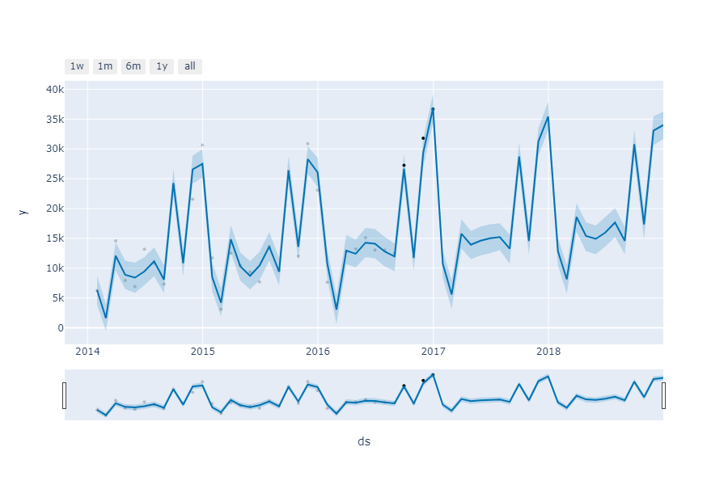
2018 SALES FORECASTING USING FBPROHET LIBRARY
Forecasted Values

Slide 8
Conclusion :
By the LSTM model the sales are going to drop in January 2018 from 31407 to 12922.
Then the sales are going to increase to from February and reaches maximum on November the sales will be 42063.
The organization can purchase and maintain high stock at July month as there is huge increase in sales from July to November.

